Slide 1
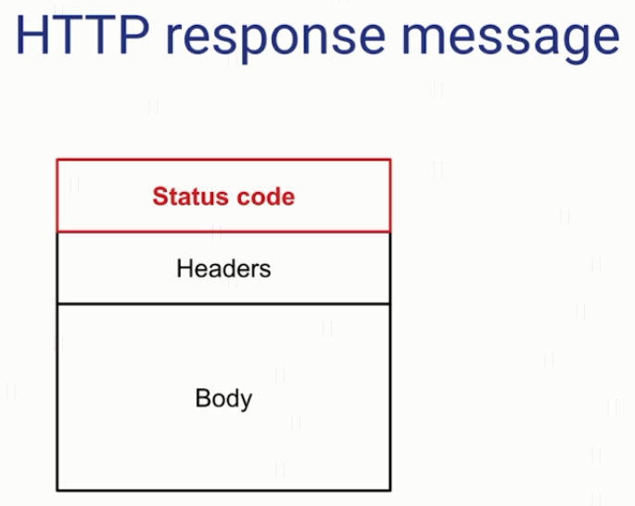
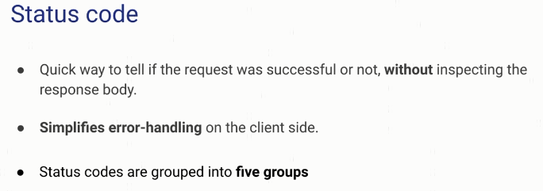
HTTP Status Code

Slide 2
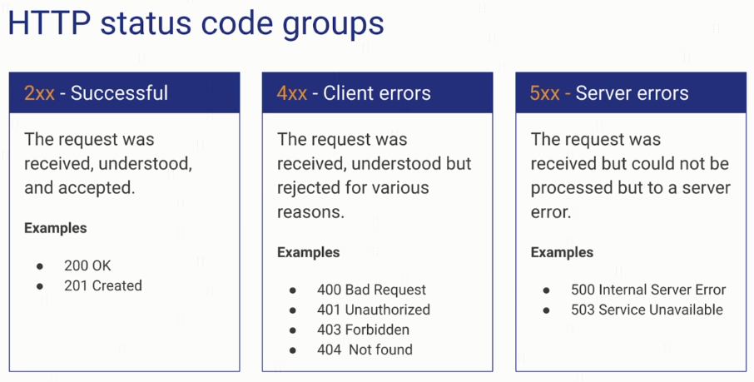
HTTP Status Code

Slide 3
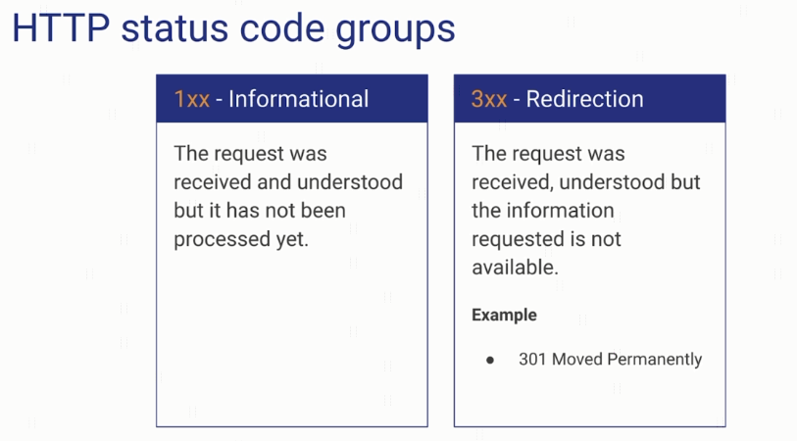
HTTP Status Code

Slide 4
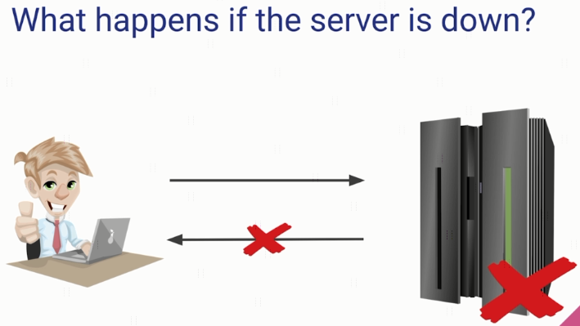
HTTP Status Code

Slide 5
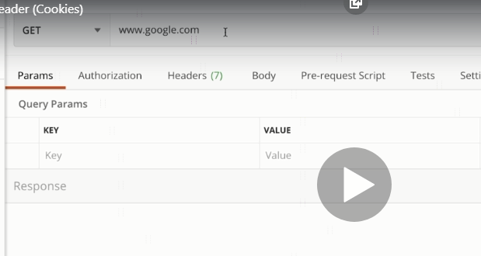
explain

Slide 6
HTTP Message Structure
https://www.udemy.com/course/introduction-to-apis-rest-api-graphql-soap-web-services-grpc/learn/lecture/19945824#overview

